Slide 1
Case Study using AlphaFold2

Slide 2
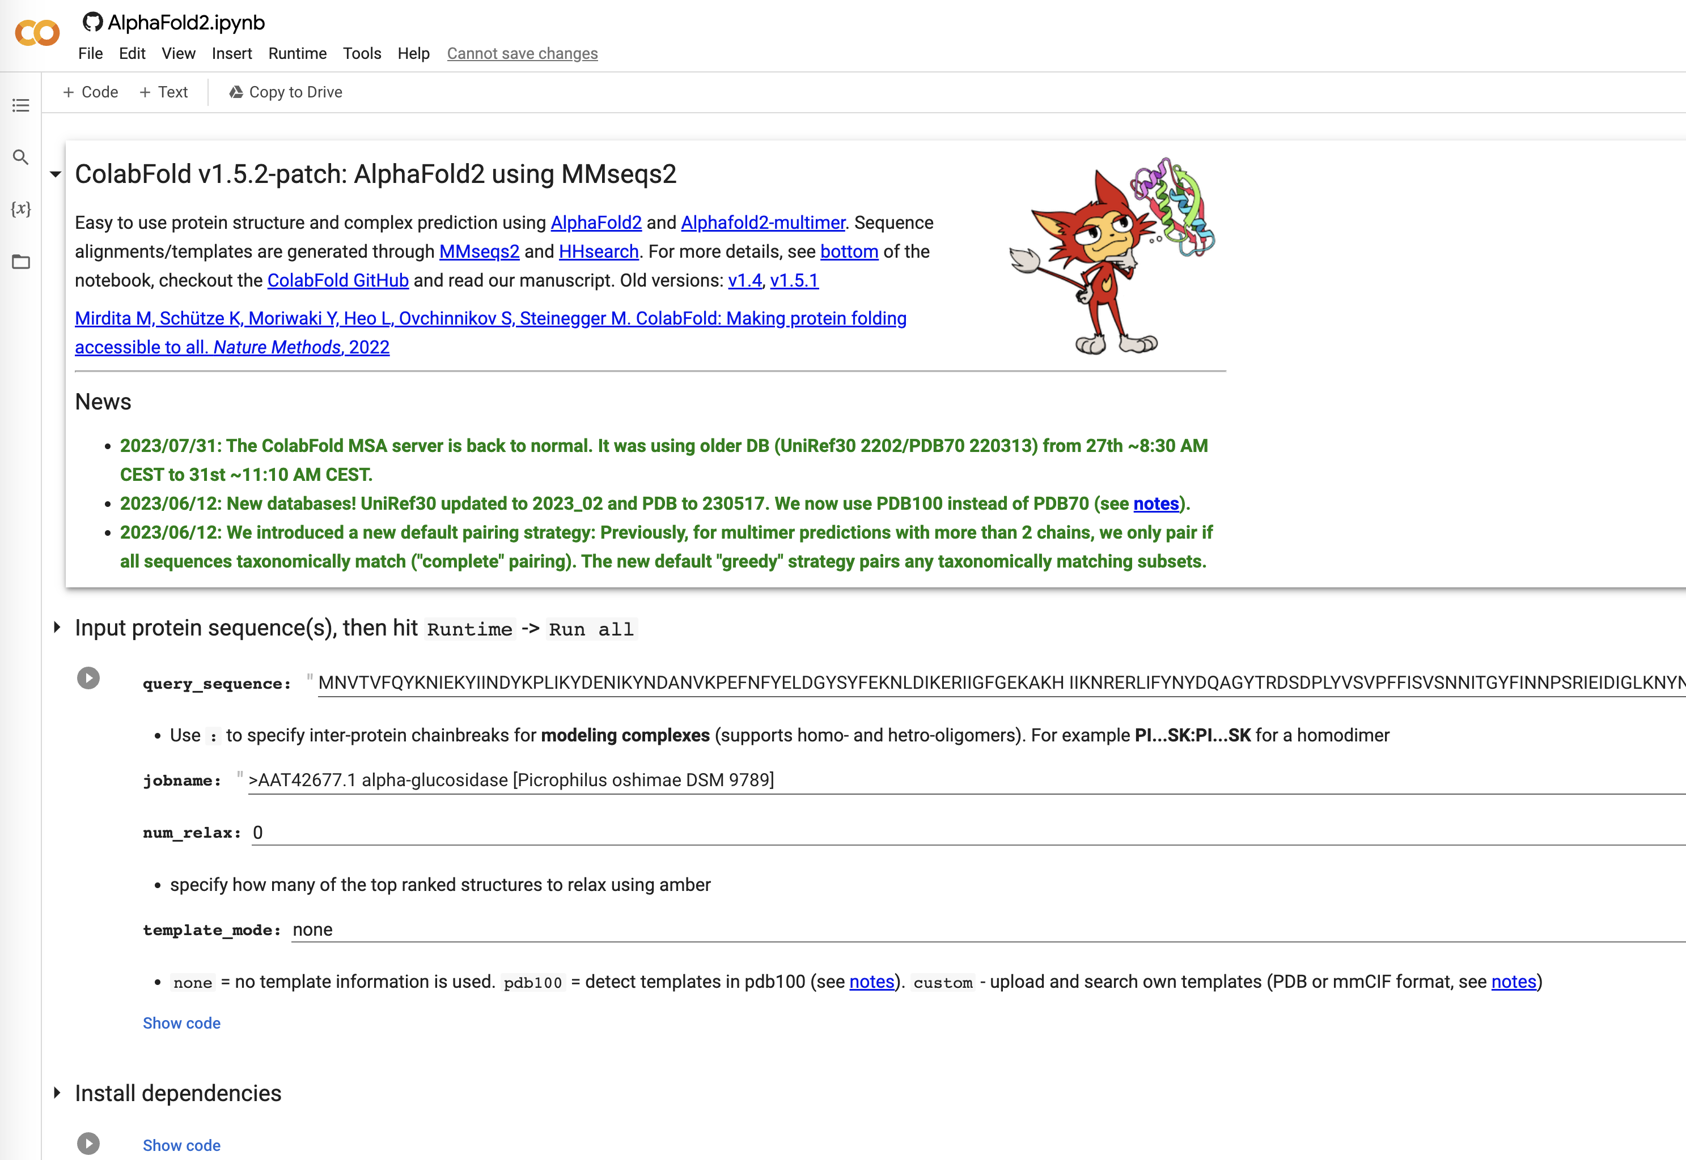
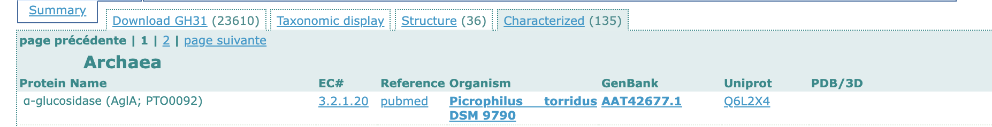
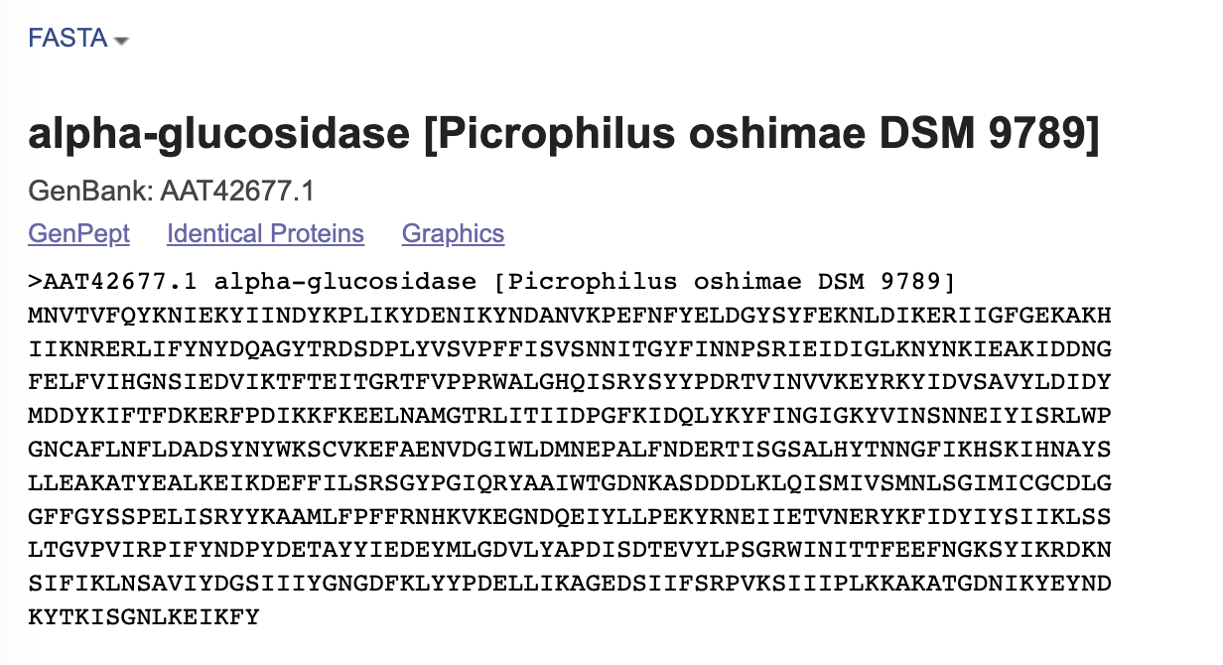
https://colab.research.google.com/github/sokrypton/ColabFold/blob/main/AlphaFold2.ipynb

Slide 3
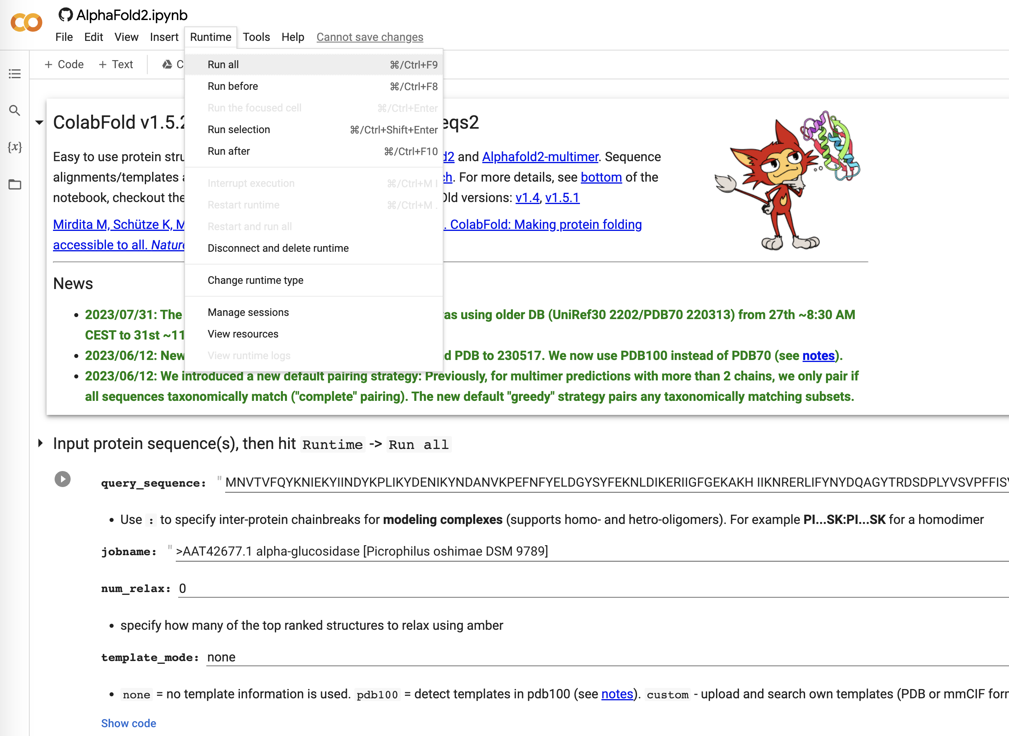
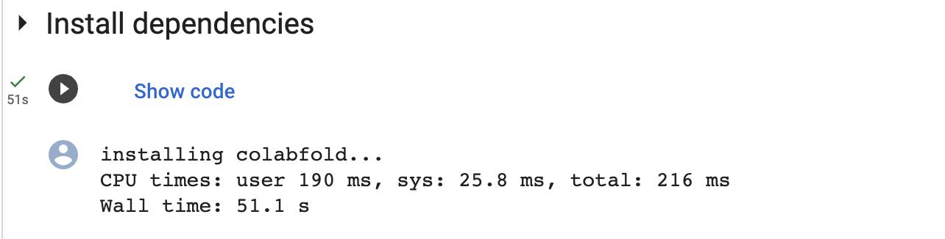
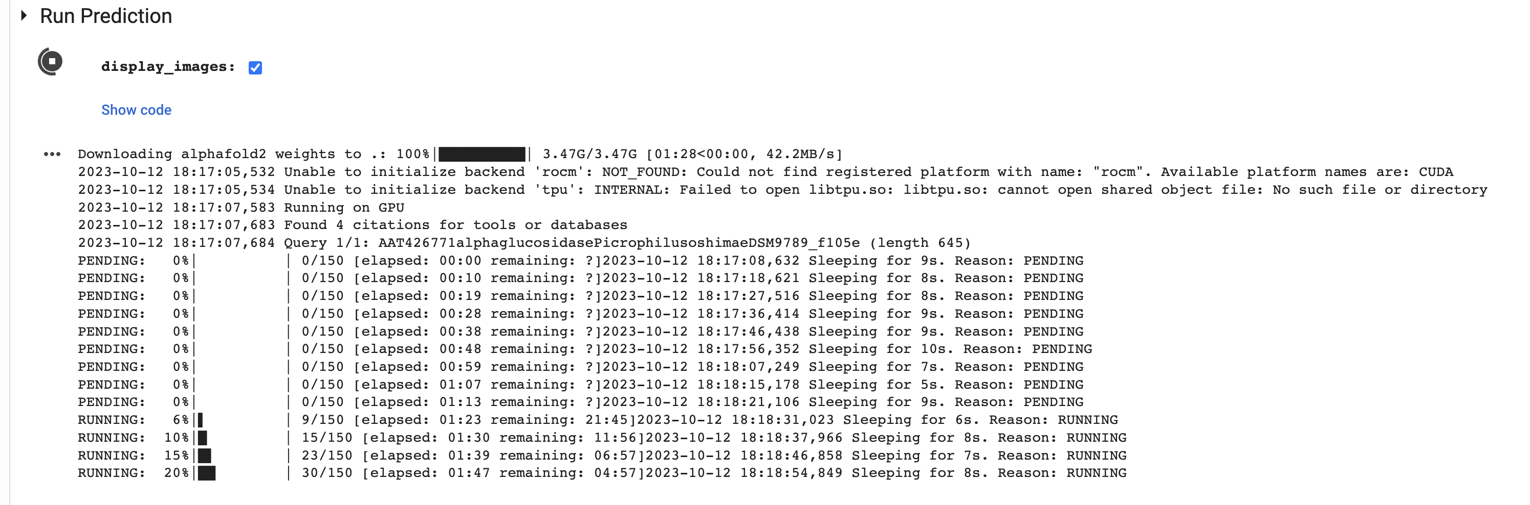
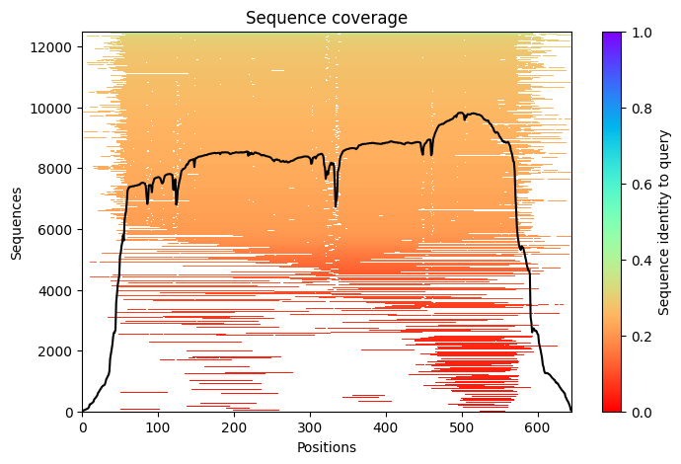
AlphaFold
Insert Query Sequence
Leave on default parameters
Run using the “Runtime → Run all”

Slide 4
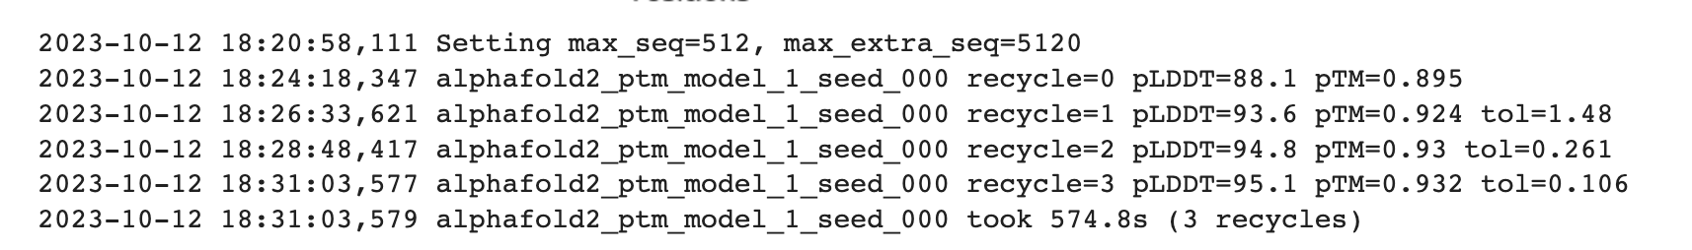
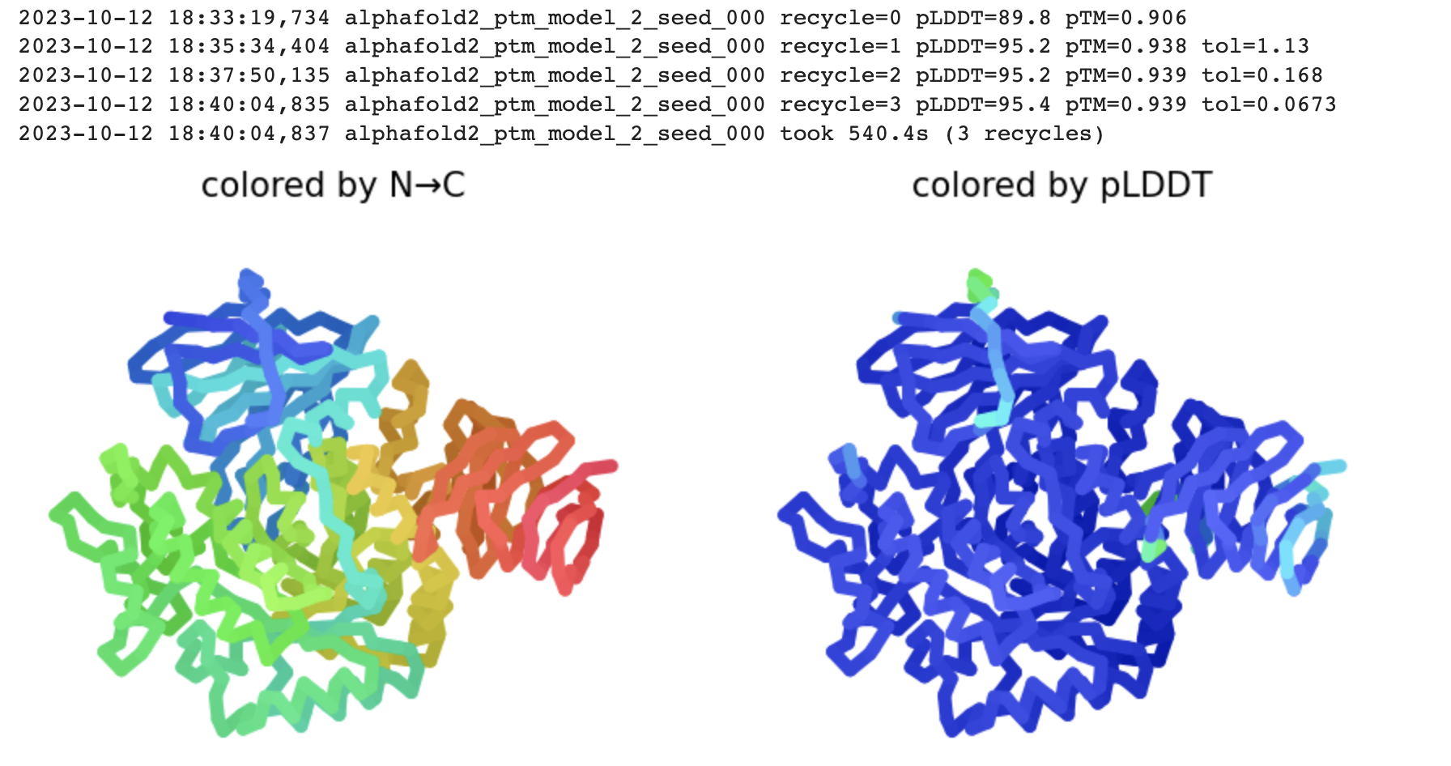
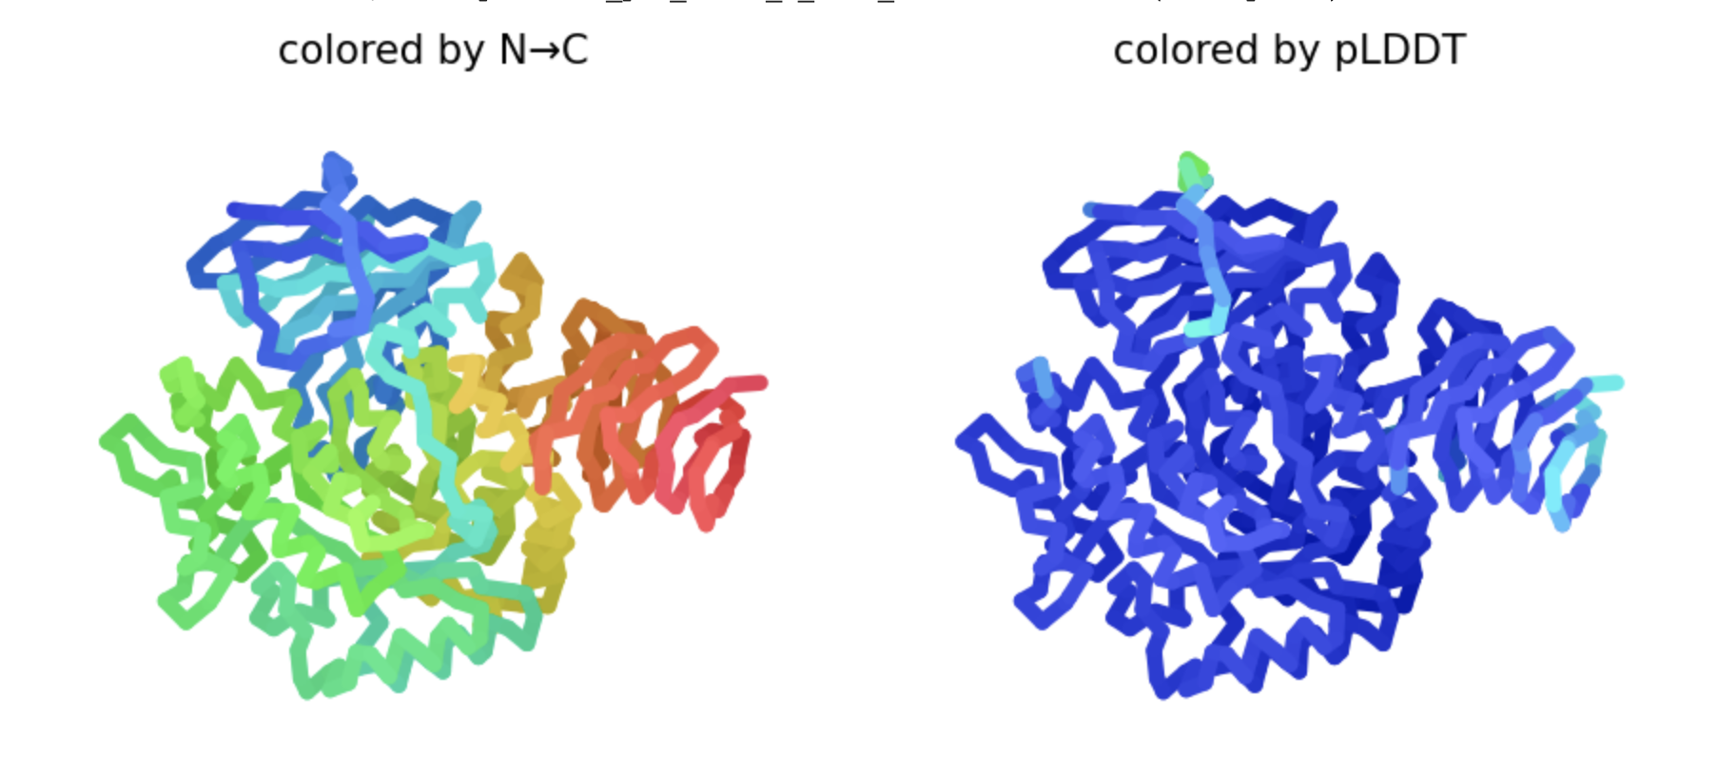
AlphaFold
pLDDT corresponds to the model's prediction of its score on the local Distance Difference Test (lDDT-Cα).
Predicted Template Modeling Score (pTM) measures the structural congruency between two folded protein structures.

Slide 5
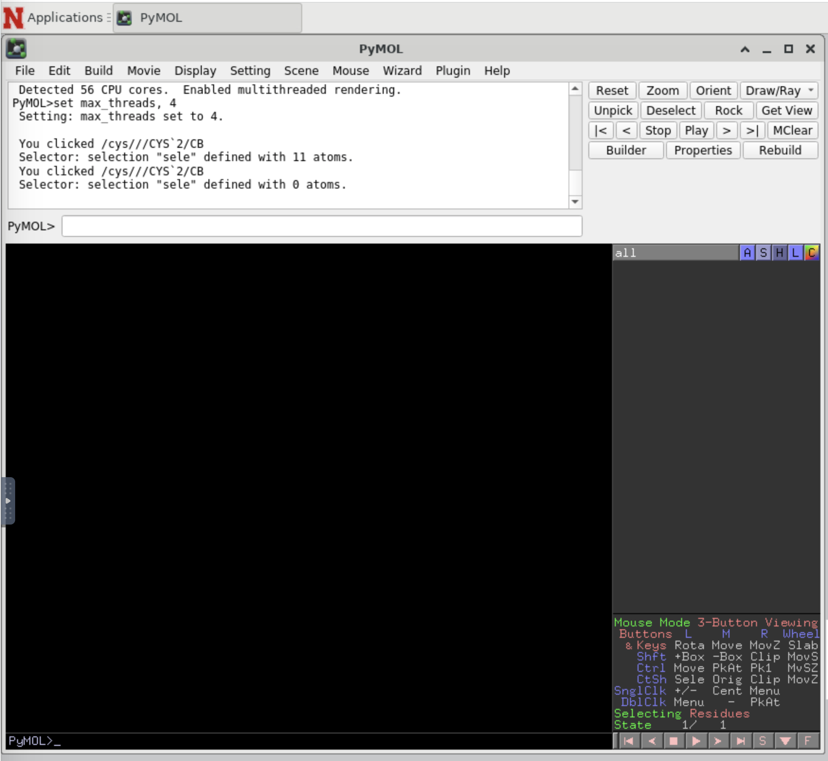
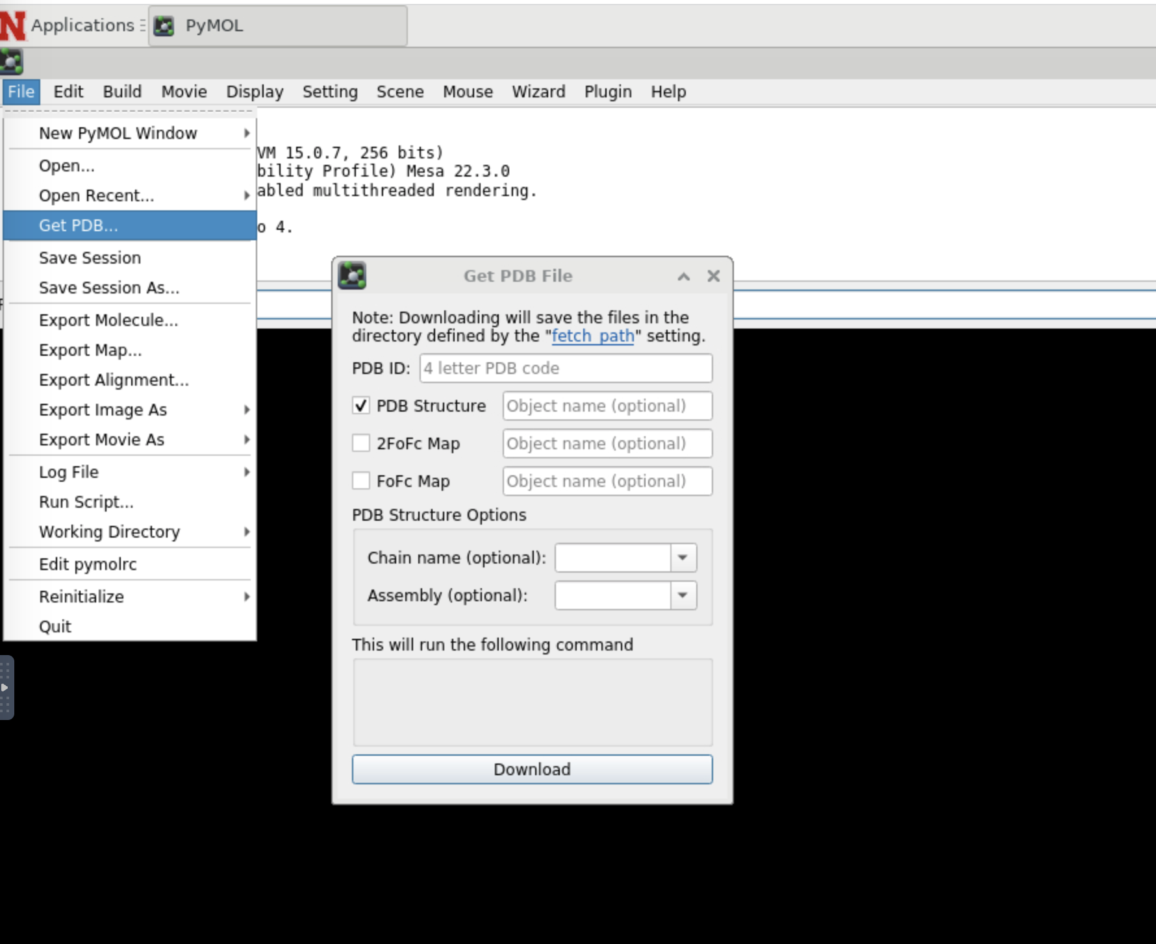
PyMOL

Slide 6
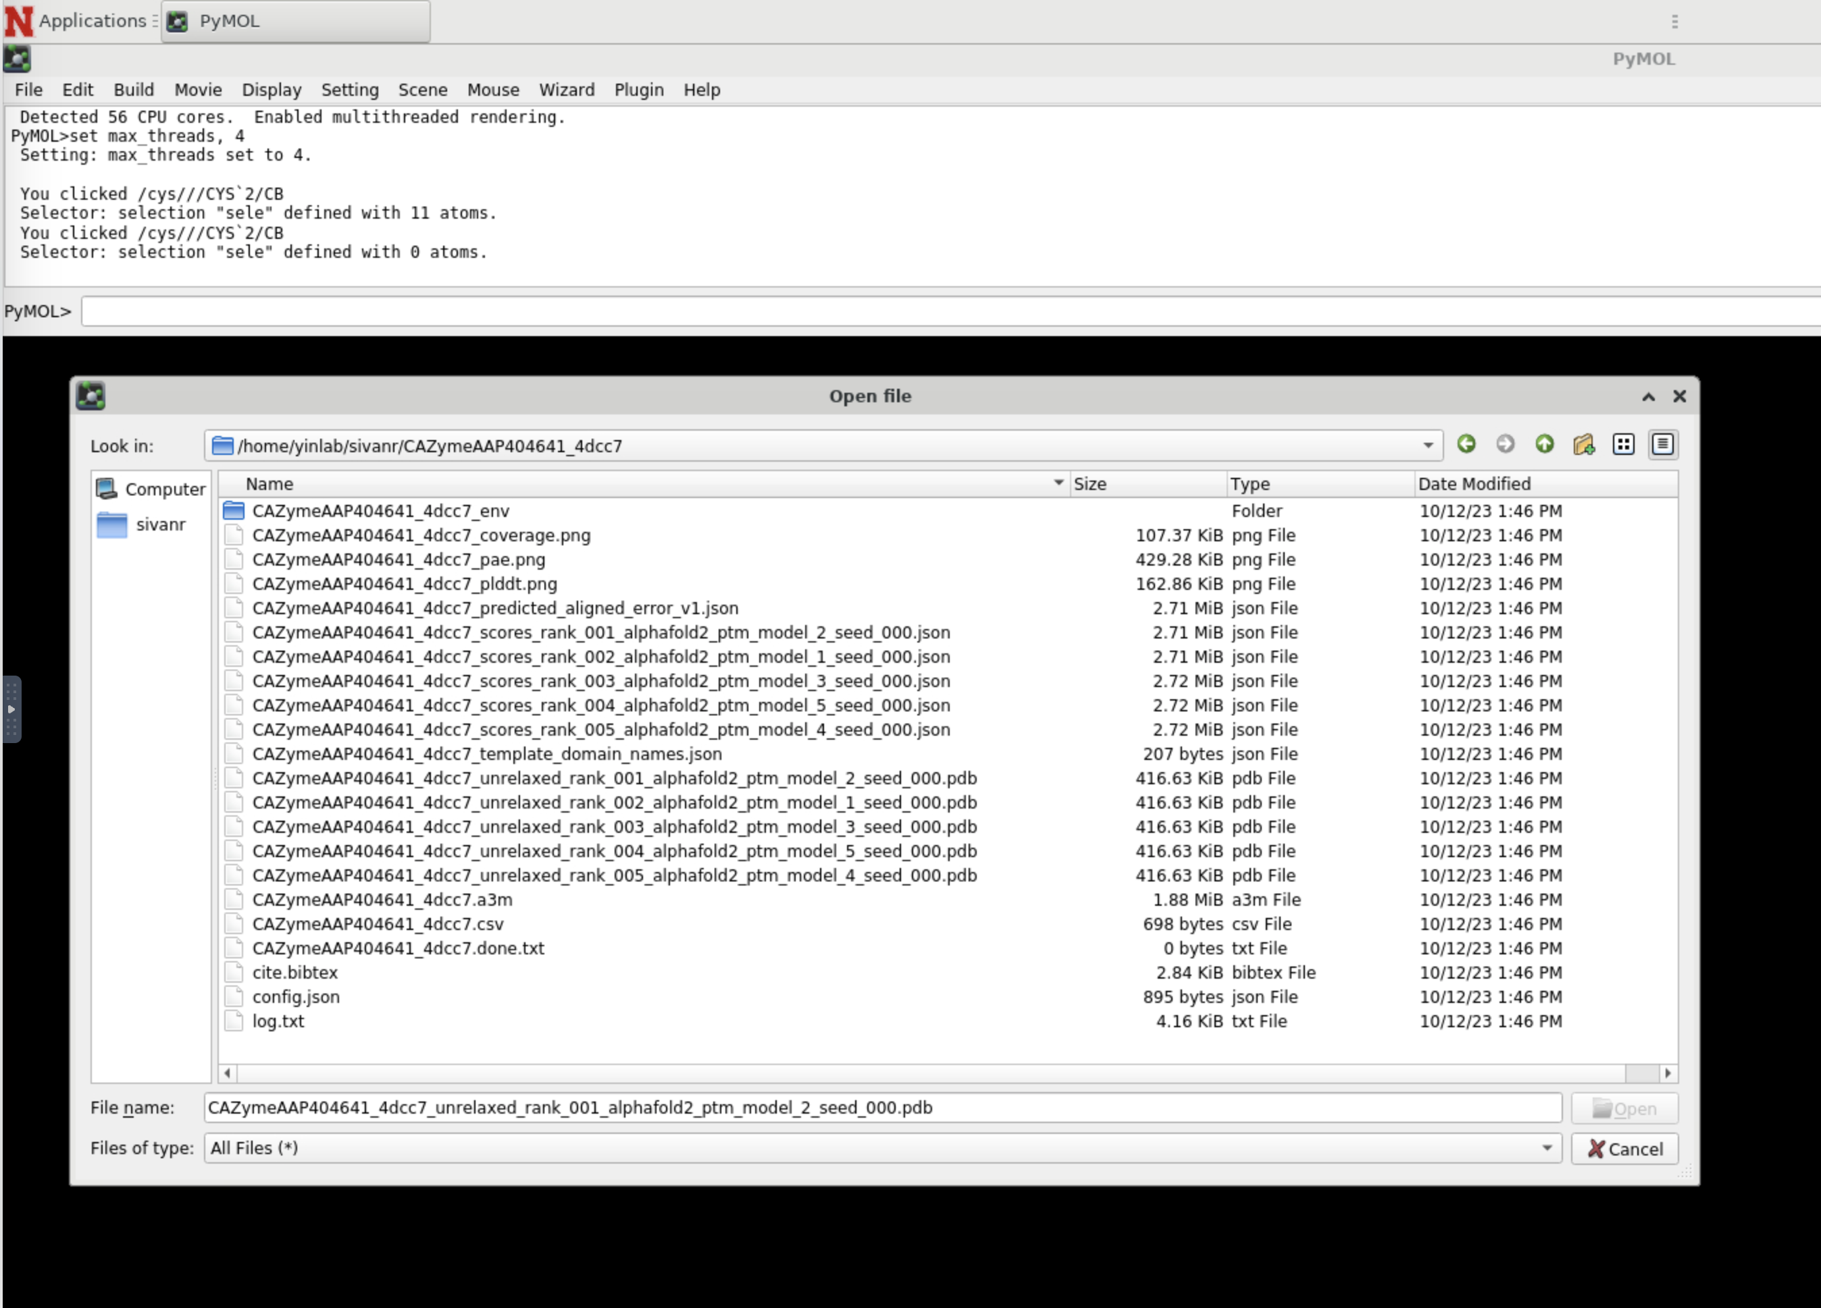
PyMOL structure loading
AlphaFold2 outputs two model accuracy estimation scores, pLDDT, and pTM, enabling the user to judge the reliability of the predicted structures.

Slide 7
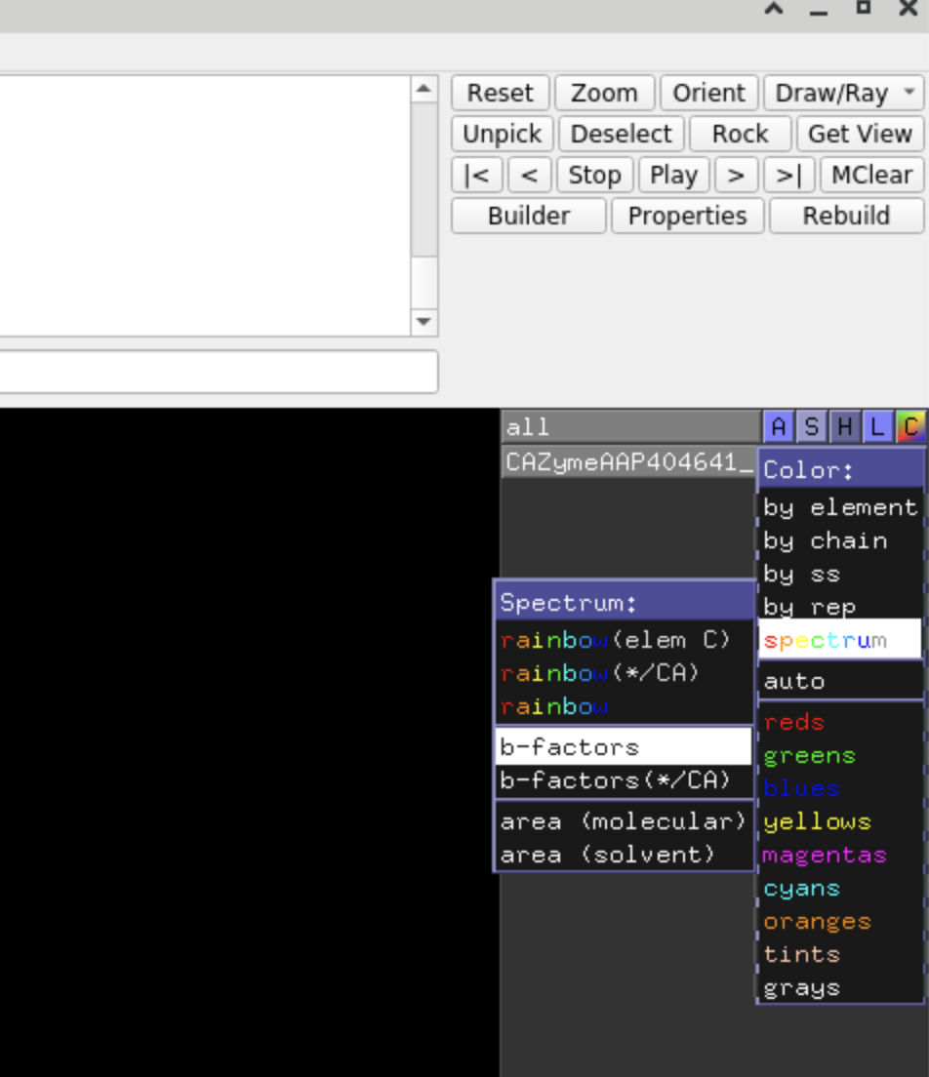
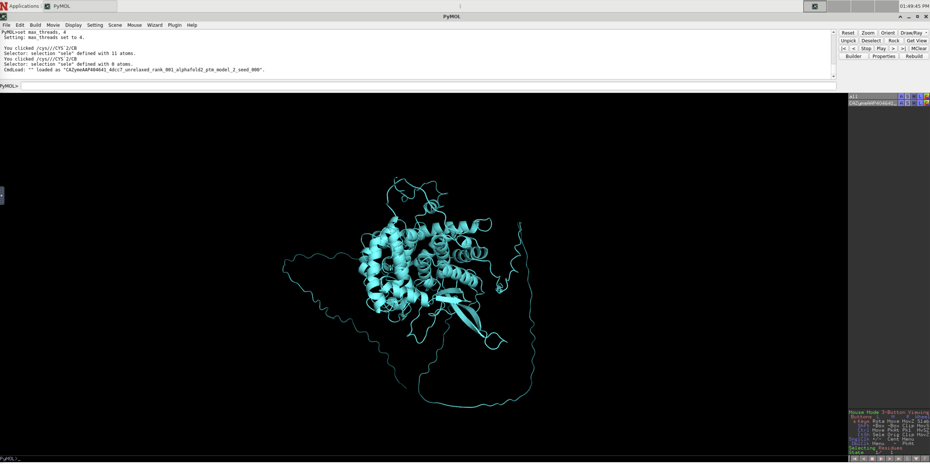
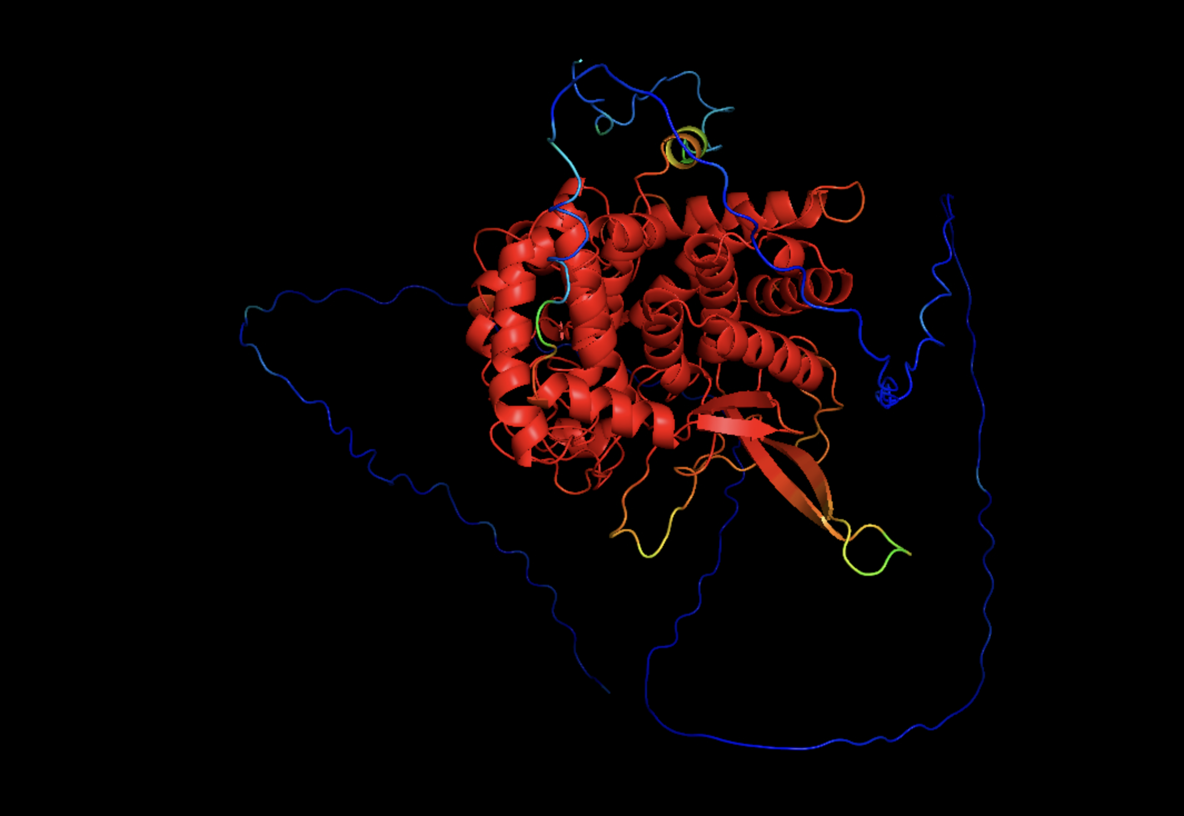
Structure visualization

Slide 8
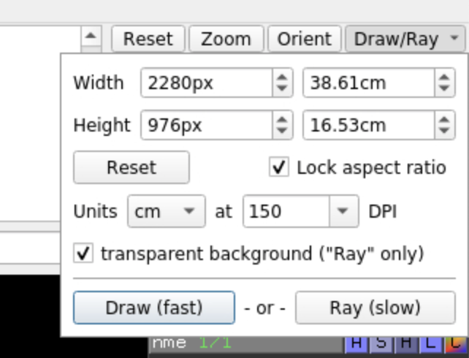
Downloading high quality images

